Slide 1
Face Mask Detection Using Tensorflow, Keras, OpenCV
K.R. KISHORKUMAR – 18BCA0104
Digital Sign.
PROF. Jabanjalin Hilda

Slide 2
OVERVIEW
Introduction
Modules
Collection of Dataset(with mask and without mask), Load the
Data, Pre-processing
Training the Data and Testing the Data
Detection of Face Mask (with or without mask)
Advantages
Conclusion

Slide 3
Introduction
According to the World Health Organization (WHO)’s coronavirus disease 2019 (COVID-19) has globally infected over 20 million people causing over 0.7million deaths. Respiratory problems like shortness of breath or difficulty in breathing is one of them. Elder people having lung disease can possess serious complications from COVID-19 illness as they appear to be at higher risk. Persons having respiratory problems can expose anyone (who is in close contact with them) to infective beads. COVID-19, wearing a clinical mask is very necessary.

Slide 4
Cont.,
This projects presents a simplified approach to serve the above purpose using the basic Machine Learning (ML) packages such as TensorFlow, Keras, OpenCV and Scikit-Learn.

Slide 5
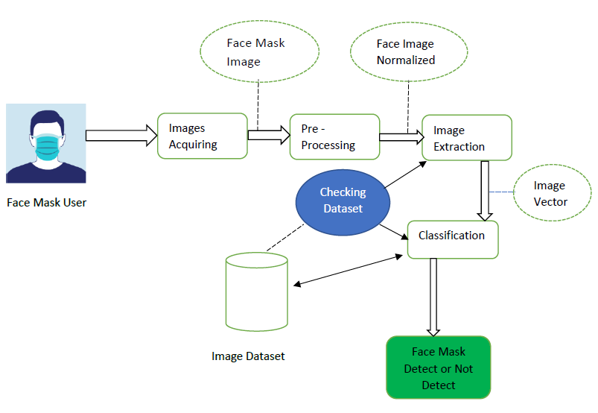
Architecture Diagram

Slide 6
Modules
Collection of Dataset(with mask and without mask), Load the Data, Pre-processing.
Training the Data and Testing the Data
Detection of Face Mask (with or without mask)

Slide 7
Collection of Dataset (with mask and without mask), Load the Data, Pre-processing.

Slide 8
Tensorflow and OpenCV
TensorFlow Datasets is a collection of datasets ready to use, with TensorFlow or other Python ML frameworks, such as Jax. All datasets are exposed as tf. data.
OpenCV (Open Source Computer Vision Library) is an open source computer vision and machine learning software library. OpenCV was built to provide a common infrastructure for computer vision applications and to accelerate the use of machine perception in the commercial products. Being a BSD-licensed product, OpenCV makes it easy for businesses to utilize and modify the code.

Slide 9
keras
Keras is an open-source software library that provides a Python interface for artificial neural networks. Keras acts as an interface for the TensorFlow library.
It was developed to make implementing deep learning models as fast and easy as possible for research and development.

Slide 10
Training the Data , Test the Data
Train and Test is a method to measure the accuracy of our
model, and 80% is training the dataset and 20% is testing the
dataset.
TensorFlow has many optimization algorithms available for
training. This model implements Keras, Tensorflow, OpenCV.

Slide 11
Detecting Face Mask (With or Without Face Mask)
Once the face mask detector is trained, we can then move on to loading the mask detector, performing face detection, and then classifying each face as With_mask or Without_mask.
Load Face Mask classifier from disk, Detect faces in images, Extract each face, Apply Face Mask classifier to each face to determine mask or no mask.

Slide 12
DNN (Deep Neural Network)
A deep neural network (DNN) is an artificial neural network (ANN) with multiple layers between the input and output layers.
There are different types of neural networks but they always consist of the same components: neurons, synapses, weights, biases, and functions.
These components functioning similar to the human brains and can be trained like any other ML algorithm.

Slide 13
Conclusion
We illustrated the learning and performance task of the model. Using basic ML tools and simplified techniques the method has achieved reasonably high accuracy. It can be used for a variety of applications. Wearing a mask may be obligatory in the near future, considering the Covid-19 crisis. Many public service providers will ask the customers to wear masks correctly to avail of their services. The deployed model will contribute immensely to the public health care system. In future it can be extended to detect if a person is wearing the mask properly or not.

Slide 14
references
[1] Loey, Mohamed, et al. "A hybrid deep transfer learning model with machine learning methods for face mask detection in the era of the COVID-19 pandemic." Measurement 167 (2020): 108288.
[2] Kalas, Mamata S. "Real time face detection and tracking using opencv." international journal of soft computing and Artificial Intelligence 2.1 (2014): 41-44.
[3] Militante, Sammy V., and Nanette V. Dionisio. "Real-Time Facemask Recognition with Alarm System using Deep Learning." 2020 11th IEEE Control
[4] Venkateswarlu, Isunuri B., Jagadeesh Kakarla, and Shree Prakash. "Face mask detection using MobileNet and Global Pooling Block." 2020 IEEE 4th Conference on Information & Communication Technology (CICT). IEEE, 2020.
[5] Das, Arjya, Mohammad Wasif Ansari, and Rohini Basak. "Covid-19 Face Mask Detection Using TensorFlow, Keras and OpenCV."

Slide 15
Cont.,
[6] Rohith, C. A., et al. "An efficient helmet detection for MVD using deep learning." 2019 3rd International Conference on Trends in Electronics and Informatics (ICOEI). IEEE, 2019.
[7] Dahiya, Kunal, Dinesh Singh, and C. Krishna Mohan. "Automatic detection of bike-riders without helmet using surveillance videos in real-time." 2016 International Joint Conference on Neural Networks (IJCNN). IEEE, 2016.
[8] Sharma, Vinay. "Face Mask Detection using YOLOv5 for COVID-19." (2020).
[9] Boyko, Nataliya, Oleg Basystiuk, and Nataliya Shakhovska. "Performance evaluation and comparison of software for face recognition, based on dlib and opencv library." 2018 IEEE Second International Conference on Data Stream Mining & Processing (DSMP). IEEE, 2018.
[10] Jiang, Mingjie, and Xinqi Fan. "RetinaMask: a face mask detector." arXiv preprint arXiv:2005.03950 (2020).

